Slide 1

ELL Leadership Academy
Karina E. Chapa, M.Ed.
Language Proficiency, Biliteracy
and Cultural Diversity Director
kchapa@esc1.net

Slide 2

Professional Learning Essential Agreements
Be respectful of others
Be an active participant
Take care of your needs
Use electronic devices as learning tools

Slide 3
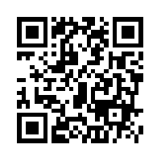
Quick Survey
http://bit.ly/2t5xZed

Slide 4
The power of cognates

Slide 5
The Power of Cognates
La chimica è la scienza che studia la composizione della materia ed il suo comportamento in base a tale composizione.

Slide 6
The Power of Cognates
La chimica è la scienza che studia la composizione della materia ed il suo comportamento in base a tale composizione.

Slide 7
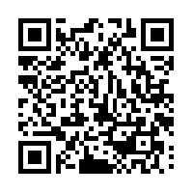
Your Turn!
1. Individually make a list of 5 academic words from any content area.
2. Turn to your partner and combine your two lists of words (even if from different content areas).
3. Find another pair and exchange your lists.
4. Write the Spanish cognates next to each academic word. Use Google Translate if needed.
5. Calculate what percentage of the words are cognates.
1 – 2 – 4 – ALL
http://www.realfastspanish.com/vocabulary/spanish-cognates

Slide 8
Factors that Impact Second Language Acquisition
Motivation and attitude
First language development
Age
Cultural background
Quality of instruction
Personality
Peers and role models
Access to the language
Language distance
Take a Stand

Slide 9
Five SLA Hypothesis
Acquisition vs Learning Hypothesis
Monitor Hypothesis
Natural Order Hypothesis
Input Hypothesis
Affective Filter Hypothesis

Slide 10
Expert Jigsaw: Tree Map
Krashen’s Five Hypothesis
Learning vs Acquisition
Monitor
Natural Order
Input
Affective Filter

Slide 11

Edmodo Code: w2pwig
www.edmodo.com

Slide 12
Session Objectives
Content Objective
Today I will examine how to implement the ELPS in all content areas and how to analyze TELPAS data to guide instruction.
Language Objective
Today I will share (orally and in writing) different ideas on how to linguistically accommodate instruction for ELLs.

Slide 13
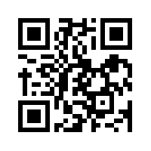
ELPS
Anticipation Guide
kahoot.it
create.kahoot.it

Slide 14
Statutory Requirement
19 Texas Administrative Code 74.4 Chapter 74. Curriculum Requirements Subchapter A. Required Curriculum 74.4 English Language Proficiency Standards
Adopted December 2007

Slide 15


ELPS Resources
LIAG and ELPS Instructional Tool

Slide 16
ELPS: How are they organized?
Big Ideas
1. Make Content Comprehensible
2. Develop Academic Language
Big Responsibilities
1. Communicated
2. Sequenced
3. Scaffolded
Student Expectations
1. Listening
2. Speaking
3. Reading
4. Writing
5. Learning Strategies
PLDs (L, S, R, W)
1. Beginning
2. Intermediate
3. Advanced
4. Advanced High

Slide 17
ELPS Mingle!
  Listening PLDs
  Listening Expectations & CCRS
  Listening Teacher Behaviors
  Speaking PLDs
  Speaking Expectations & CCRS
  Speaking Teacher Behaviors
  Reading 2-12 PLDs
  Reading Expectations & CCRS
  Reading Teacher Behaviors
  Writing 2-12 PLDs
  Writing Expectations & CCRS
  Writing Teacher Behaviors

Slide 18
TELPAS-ELPS Connection
Utilizing TELPAS to Guide Instruction

Slide 19
TEKS vs ELPS
STAAR
TELPAS
T
E
K
S
E
L
P
S

Slide 20
TEKS vs ELPS
Academic Proficiency Language Proficiency
STAAR
TELPAS
TEKS
ELPS
Relating Factor: evaluates/measures

Slide 21
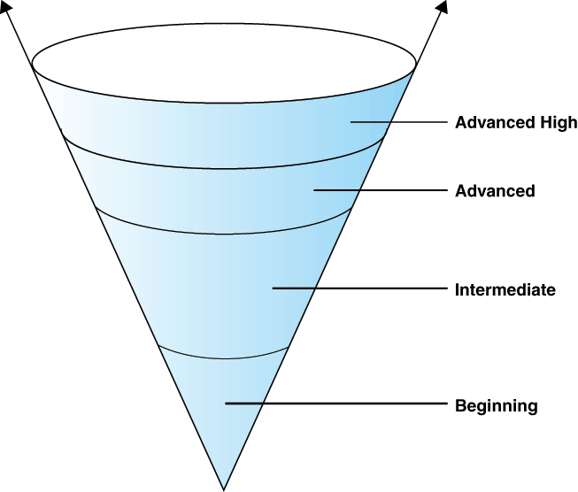
TELPAS Levels

Slide 22
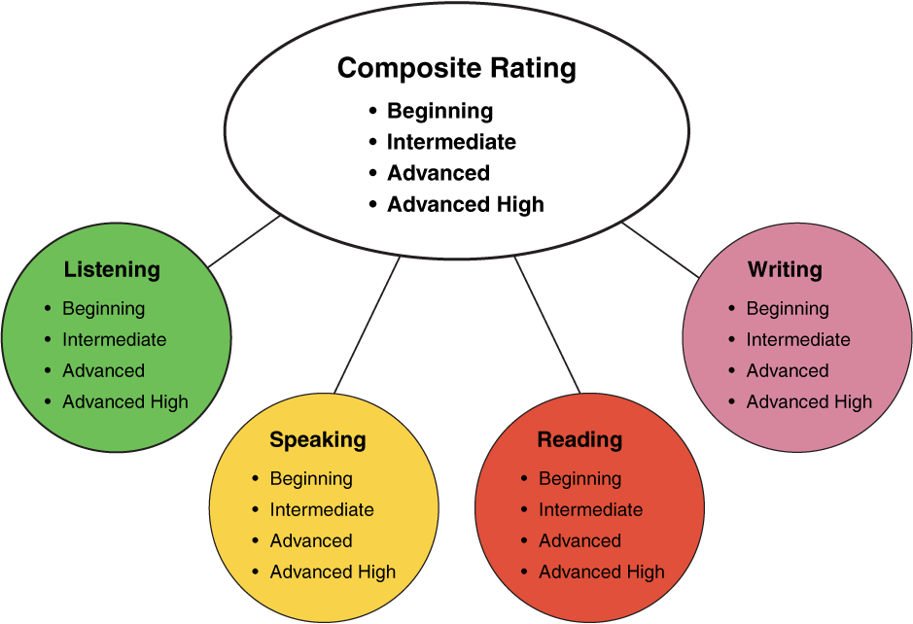
TELPAS Domains
10%
30%
10%
50%

Slide 23
ELPS Resources
LIAG and ELPS Instructional Tool
+
DMAC Reports

Slide 24
DMAC TELPAS Reports
How to Run TELPAS Reports by Language Domain
Go to Home Page
Go to State Assessment
Select TELPAS
Select Instructional Reports
Select Student Language Proficiency Rating
Generate Report

Slide 25
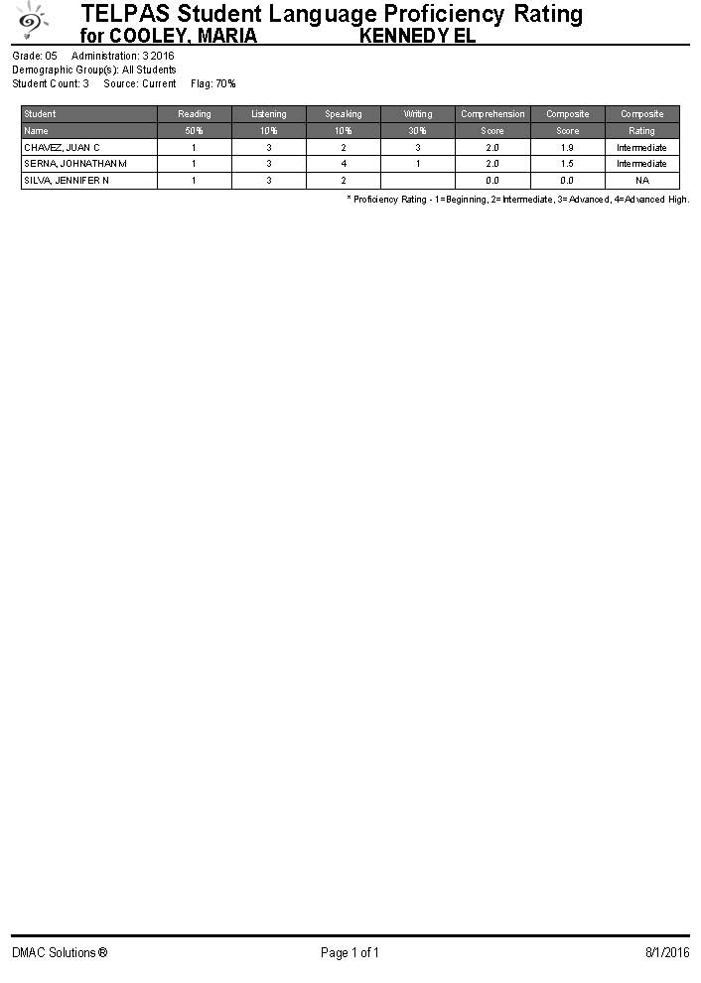
Sample DMAC Report

Slide 26
LPAC Procedures
Instructional Impact

Slide 27

Providing Comprehensible Input
http://programs.esc20.net/default.aspx?name=lpac.resources

Slide 28
LPAC Procedures
Initial Identification Process

Slide 29
LPAC Procedures
Initial Identification Process

Slide 30
ELL Exit Criteria

Slide 31
Session Objectives
Content Objective
Today I examined how to implement the ELPS in all content areas and how to analyze TELPAS data to guide instruction.
Language Objective
Today I shared (orally and in writing) different ideas on how to linguistically accommodate instruction for ELLs.

Slide 32
Tickets Out
I used to think…
But now I know…

Slide 33
Thank you for your participation!
Karina E. Chapa, M.Ed.
Language Proficiency, Biliteracy and Cultural Diversity Director
kchapa@esc1.net
Facebook: Region One ESC Bilingual
Twitter @esc1bilingual

